Slide 1
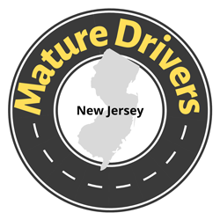



New Jersey MATURE DRIVER Resource Center
Train the Trainer
Notes:
Welcome.
This presentation was developed by staff at the Alan M. Voorhees Transportation Center at the Rutgers University Edward J. Bloustein School of Planning and Public Policy. This effort is part of the New Jersey Mature Driver Resource Center that functions as a central location for information and links to resources related to New Jersey’s mature drivers. Funding for the development of the Resource Center came from the New Jersey Division of Highway Traffic Safety with funds from the Federal Highway Administration.
This presentation provides information and resources to individuals who will be interacting with mature drivers and discussing how to drive safer longer, and when the decision has been made to limit or stop driving, how to make the transition. This presentation is available to you to use in your communities – you will download it from the maturedriversnj.org website. This presentation is customizable for you to tailer it directly to your community or your specific audience’s need.
The presentation will take about 1.0 hour.
We will discuss four main topics – Changes with Aging, Driving Safer Longer, Limiting or Stopping Driving or Driving Retirement, and Transportation Services. We will stop at the end of each section to answer questions.
In this presentation, we refer to Information and links to resources that can be found at the NJ Mature Driver Resource Center website, maturedriversnj.org.
The links on some of the slides are live and can be brought up during your presentation.
At the end of this presentation, we will give you a form to complete to help us assess the usefulness of the training. This training material is new and we want to identify gaps as soon as possible.
Note to Presenters: Use the Introduction below
This presentation provides information and resources to individuals who will be interacting with mature drivers and discussing how to drive safer longer, and when the decision has been made to limit or stop driving, how to make the transition.
The presentation will take about 1.0 hour.
We will discuss four main topics – Changes with Aging, Driving Safer Longer, Limiting or Stopping Driving or Driving Retirement, and Transportation Services. We will stop at the end of each section to answer questions.
In this presentation, we refer to Information and links to resources that can be found at the NJ Mature Driver Resource Center website, maturedriversnj.org.

Slide 2
Introduction

Slide 3
Introduction
New Jersey’s Mature Drivers
21% of NJ’s licensed drivers are aged 65 or older
Proportion of crashes increased to over 17% in 2020
Comprised almost 26% of all driver fatalities in 2020
Involved in 14% of both pedestrian and bicycle crashes (2016-2020)
Distracted driving a factor in over 25% of all crashes (2015-2019)
Notes:
Of New Jersey’s over six million total licensed drivers, 21 percent are aged 65 or older. Over the past decade, the number of crashes involving mature drivers has remained high while the proportion of crashes involving mature drivers has increased, raising concerns about the potential impacts of an aging population on roadway safety. (FHWA)
According to the 2022 NJ Division of Highway Traffic Safety Highway Safety Plan (HSP), the proportion of crashes involving mature drivers in New Jersey increased to over 17 percent as of 2020.
Older drivers are often safer drivers. However, when they are involved in a traffic crash, older drivers are more likely to be severely injured or killed in that crash. Older drivers also represent a large proportion of roadway deaths, having accounted for almost 26 percent of all driver fatalities in the State in 2020.
As the number of overall crashes involving mature drivers increases over the years, mature drivers have a substantial impact on the safety of vulnerable road users, including pedestrians and bicyclists. Between 2016 and 2020, about 14 percent of pedestrian crashes and 14 percent of bicycle crashes involved mature drivers.
From 2015-2019, the most common factor for crashes involving mature drivers was distracted driving, with distraction as a factor in over 25 percent of all crashes involving mature drivers during that time period.

Slide 4
Changes with Aging
Vision, Hearing, Cognition
Physical Condition
Making Adjustments
Notes:
Let’s start by discussing the changes that occur with aging that can affect driving, and how to help people drive safer longer through driving assessment, driving instruction, and driving technology.

Slide 5
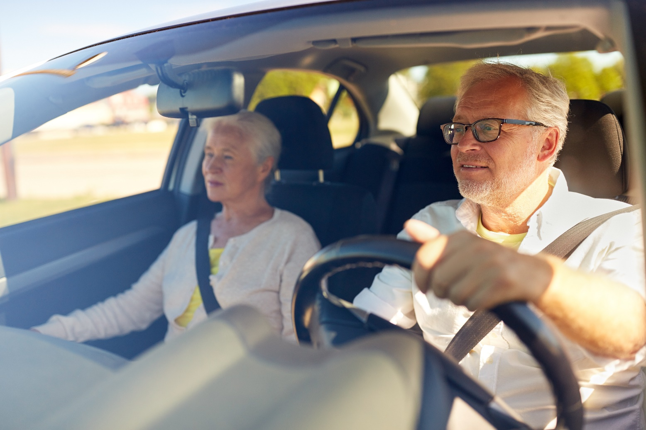
Changes with Aging
Vision
Hearing
Cognition
  Memory
  Mental alertness
Physical Condition
  Reaction time
  Strength and flexibility
  Range of motion
Medical Conditions
Medications
Notes:
We can’t say that someone should stop driving because they reach a particular age – 70, 80, even 90. People age at different rates. The ability to drive safely is based on both physical ability and mental acuity. When looking at driving and aging, it is important to consider the specific changes that could impact an older adult’s ability to drive safely.
The normal aging process involves physical and cognitive changes that may affect driving skills, and for some individuals, disease or medication can compromise driving ability. Changes in vision, hearing, cognitive skills, and physical condition, such as flexibility and response times, can require adaptations to maintain safe driving, or require driving retirement. However, being aware of those changes, assessing their impact, and participating in driver training may help older adults continue to drive safely.

Slide 6

Changes with Aging
Vision
  Cataracts
  Macular Degeneration
  Glaucoma
  Changes in night vision, light sensitivity
Notes:
It is normal to experience changes as we age. Some changes, such as dementia, Alzheimer’s, and Parkinson’s affect only some people. The effects of medication are also specific to individuals.
When we think about changes in driving ability, we may think of vision first. Most older people will experience changes in night vision and light sensitivity but other conditions can have an impact on driving. Vision tests can help determine any deficiencies.

Slide 7

Changes with Aging
Hearing problems
  Sirens with car windows rolled up
  Clicking of turn signals when on
  High-pitched voices or sounds
  Following a conversation, especially when focused on driving
Notes:
Drivers take cues from what they hear around them. Older drivers may have difficulty tracking sounds in their environment such as sirens, or other high-pitched noise. They may be more distracted by conversation in the car.

Slide 8
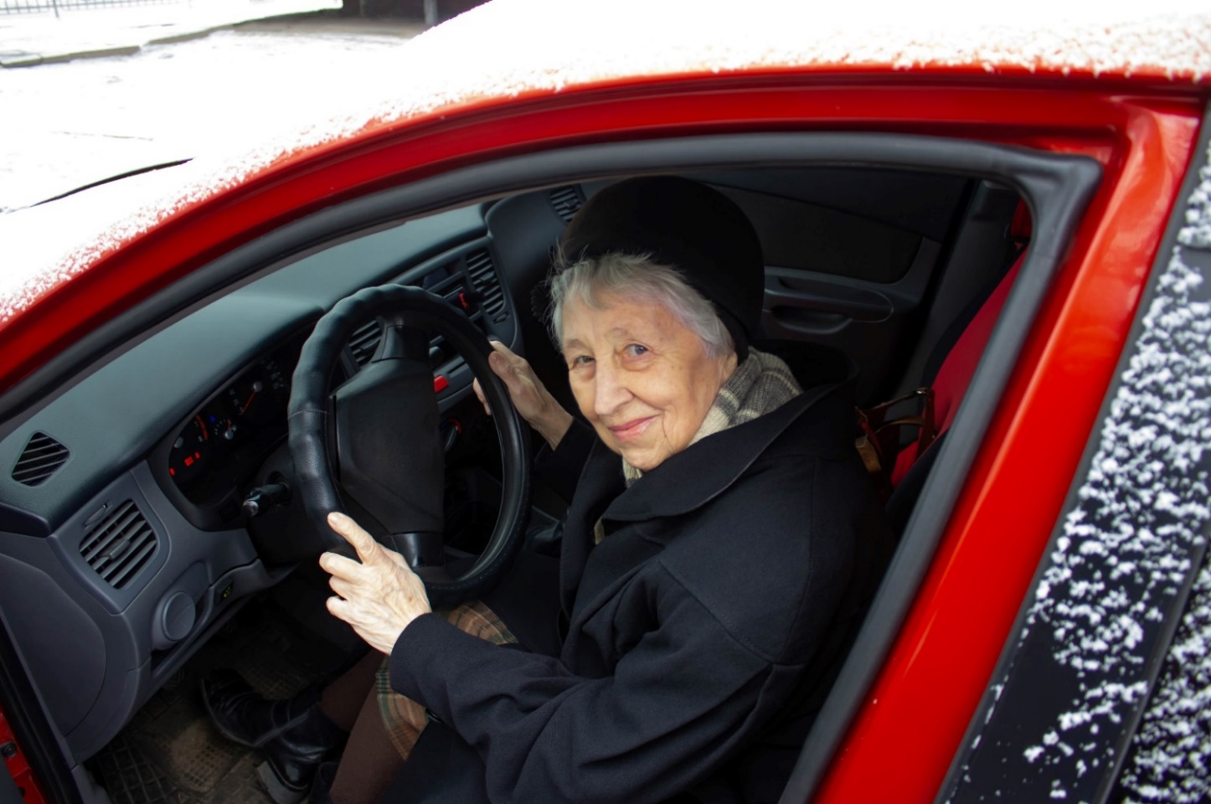
Changes with Aging
Cognition
  Short-term memory issues
  Sleep disorders
  Stroke
  Vertigo
  Parkinson’s disease
Affect response time and
wayfinding
Increase distracted driving
Notes:
Driving is a cognitively complex activity, Cognitive deficits, such as memory issues, sleep disorders, stroke, vertigo, and Parkinson’s disease, can seriously compromise driving abilities including response time and wayfinding, and can increase distracted driving.

Slide 9

Changes with Aging
Physical Condition
  Arthritis
  Diminished muscle strength
  Tired muscles, sore joints
Example Effects
  Difficult to turn neck to park
  Difficult to get into and out of car Limited ability to press brake and accelerator repeatedly
Notes:
Arthritis can stop an individual from moving and bending shoulders, hips, hands, head, and neck. This can limit their ability to:
• Get into and out of the car.
• Hold and turn the steering wheel.
• Turn the ignition key.
• Fasten the seat belt.
• Move their head quickly and fully.
• Look over their shoulder to check for cars in their blind spot.
• Look left and right at intersections.
• Make turns safely.
• Reverse a car into a parking space.
• Press the clutch pedal.
• Press the brake and accelerator, especially in heavy traffic or driving during rush hours.
• Look for oncoming traffic.

Slide 10
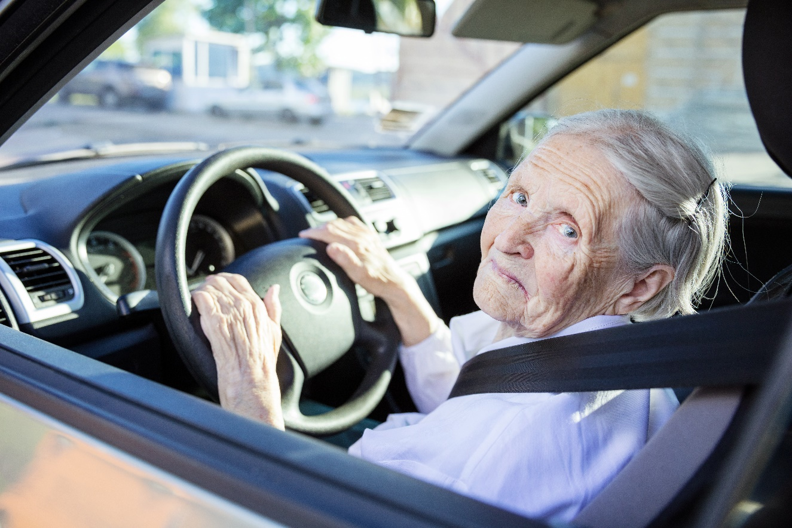
Changes with Aging
Medication
  OTC medications may make you drowsy
  Certain prescription medications can also impair driving, including:
    Antihistamines
    Antianxiety/Antidepressant medication
    Glaucoma medication
    Parkinson’s medication
    Muscle relaxants
    Opioids
    Sleep aids
  Resources: https://www.nhtsa.gov/road-safety/older-drivers
Notes:
Over the Counter and prescription medications may affect the older driver’s ability to remain alert and focused.
Read slide
Note to Presenter:
The National Highway Traffic Safety Administration link provides guidance on driving when taking medications.

Slide 11
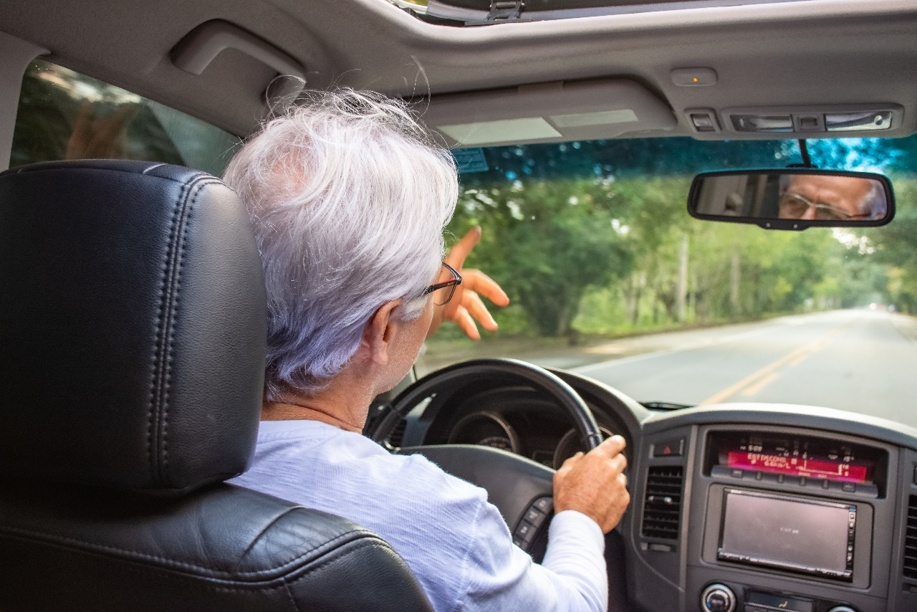
Changes with Aging
Making Adjustments
  Draw on driving experience
  No left turns
  Drive shorter distances
  Take more breaks
  Avoid rush hour and bad weather, and nighttime driving
  Use adaptive technology, but avoid distractions
Notes:
Older drivers may make adjustments for these physical and mental changes as they become more cautious and less comfortable behind the wheel.
They may stop making left turns.
They may drive shorter distances and take more breaks on a longer trip.
They may choose to avoid traffic congestion, such as during rush hour, and high speed roadways. They may choose not to drive in bad weather or at dusk or nighttime.
And technology available in newer cars can be helpful to older drivers if they are familiar with how to use it.

Slide 12
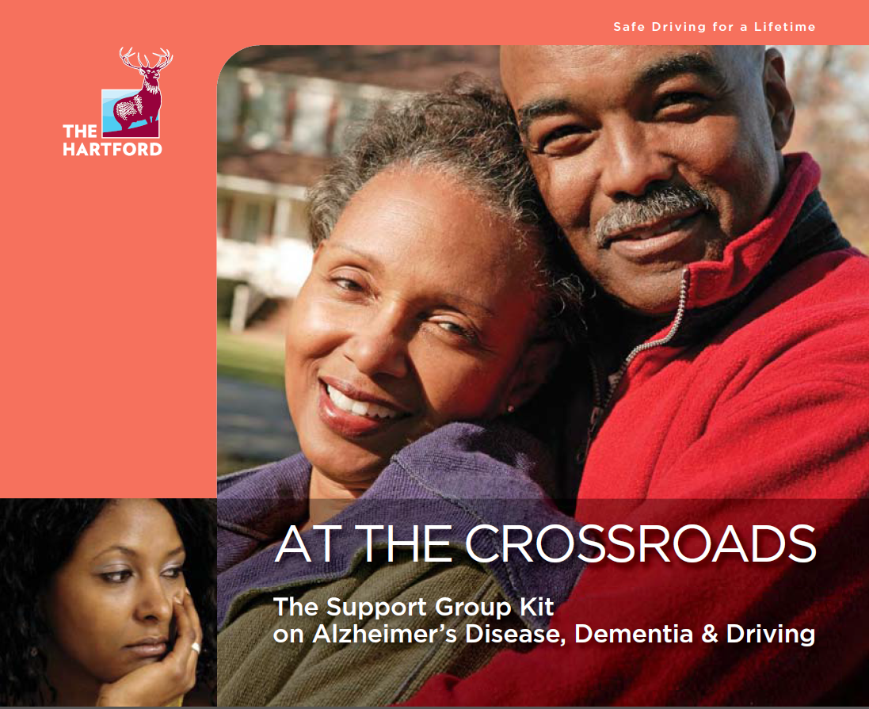
Changes with Aging
Dementia and Alzheimer's
  Hartford At the Crossroads Guidebook
  National Institute on Aging
  Alzheimer’s Association
Notes:
Several sources of guidance are available for information on driving and dementia and Alzheimers. The Hartford At the Crossroads Guide is one resource, and information is available from the National Institute on Aging and the Alzheimer’s Association.

Slide 13
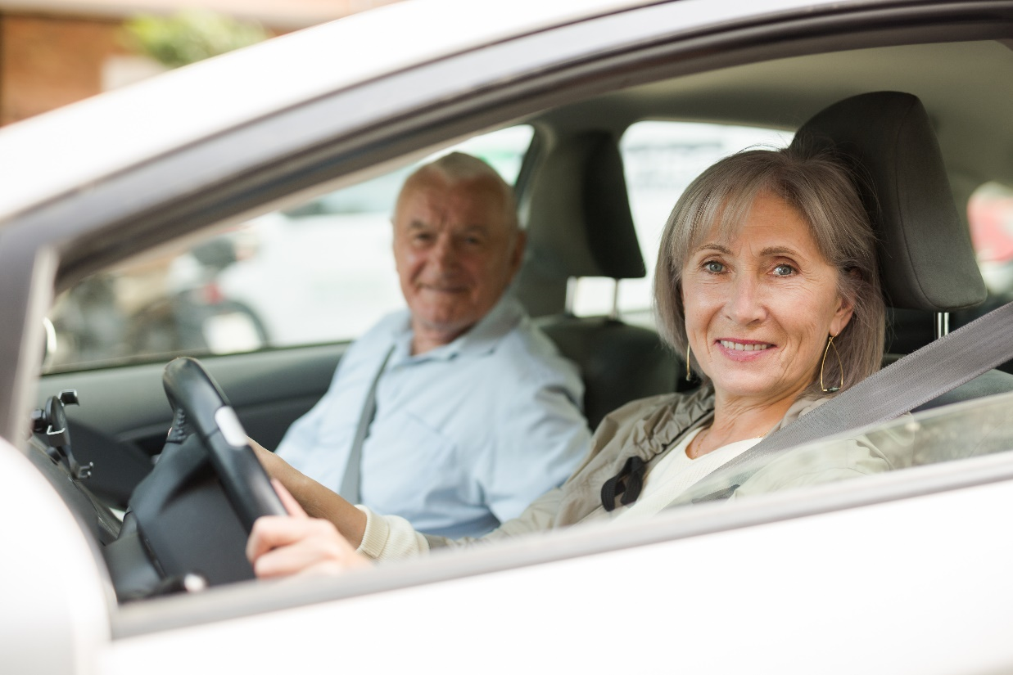
Changes with Aging
General Resources
Merck Manual
  https://www.merckmanuals.com/home/older-people%E2%80%99s-health-issues/the-older-driver/the-older-driver?redirect=vanity
  ChORUS – Clearinghouse for Older Road User Safety
  https://www.roadsafeseniors.org/guides
Notes:
Other resources on Changes with Aging and Mature Drivers can be found through these two websites - The Merck Manual and the Clearinghouse for Older Road User Safety or ChORUS. They have a range of information on various related topics.
The Merck Manual for The Older Driver is part of a series of free Manuals provided with the goal of making accurate medical information accessible and usable. Two versions are available, one for medical professionals and one for consumers.
The Clearinghouse for Older Road User Safety or ChORUS serves as a one-stop-shop for materials and resources related to lifelong safe, independent mobility. Materials and information are available for varied audiences, including older drivers and family members and caregivers of older drivers.

Slide 14
Questions?
  www.maturedriversnj.org

Slide 15
DRIVING SAFER LONGER
Assessment
Instruction
CarFit
Vehicle Technology
Vehicle Adaptation
Notes:
As we noted, people age at different rates. When looking at driving and aging, it is important to consider the specific changes that could impact a particular individual’s ability to drive safely.
We may experience physical and cognitive changes with aging, but many resources are available to help us drive safer longer. We can address some of these changes through driving assessment, driving instruction, and driving technology, CarFit events, and vehicle adaptation.

Slide 16
Driving Safer Longer - Assessment
Medical Review and Fitness to Drive Assessments
NHTSA Driving Safely while Aging Gracefully: Self-Assessment
HealthinAging.org Driving Safety Questionnaire
AAA: Evaluate Your Driving Ability
University of Florida: Fitness to Drive Screening Measure
CHORUS Assessment Tools
Certified Driving Rehabilitation Specialists (CDRS)
Occupational Therapist with training in Driving Assessment
Notes:
Driving assessment can be made through use of an online assessment tool, or through an in-person assessment.
There are several online self-assessments available through the National Highway Traffic Safety Administration, Health in Aging, Automobile Association of America (AAA), and AARP.
AAA offers in-person driving skills evaluations,
An assessment can also be made by a certified driving rehabilitation specialist. These specialists can be helpful, particularly for individuals with a disability when it is clear that some modifications to an vehicle will be needed.
And some occupational therapists have training in driving assessments.

Slide 17

Driving Safer Longer - Instruction
Online Courses
AAA RoadWiseTM Driver courses
AARP Smart Driver online course
In-person Courses
AAA RoadWiseTM Driver courses
AARP Smart Driver in-person course
NJ Motor Vehicle Commission list- Mature Defensive Driver Courses
*There are costs associated with these trainings.
Notes:
A driving refresher course can be helpful and both online and in-person courses are available. Many courses are geared specifically to older drivers.
AAA and AARP offer courses and the NJ Motor Vehicle Commission provides a list of companies with training tailored to mature drivers.
There are costs associated with these courses.

Slide 18

Driving Safer Longer - CarFit
CarFit Program (AAA, AARP, and AOTA)
Ensure vehicle “fits” driver properly
AAA offers trainings
Find trainings by state on the CarFit website
American Occupational Therapy Association CarFit webpage
CarFit events are free
Notes:
CarFit is a community-based, educational program developed by AAA, AARP and AOTA (American Occupational Therapy Association) to promote continued safe driving and mobility among older drivers by focusing attention on safety, comfort and fit. At CarFit events, trained volunteers review a 12-point checklist with driving participants to assess how well the driver fits in their vehicle and to explain vehicle safety features. In these 20-minute sessions, technicians often recommend minor alterations of the car seat, steering wheel, and mirrors for a better and safer fit.
CarFit classes are offered through AAA and other organizations throughout New Jersey at no cost. Some events are listed on the CarFit webpage, but not all events. You can contact AAA to request a CarFit class in your community.
The American Occupational Therapy Association CarFit webpage has more information about the process.

Slide 19
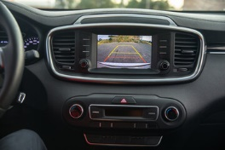

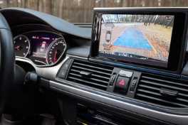
Driving Safer Longer - Driving Technology
Vehicle Technology
Smart headlights (adaptive headlights)
Emergency response systems
Back-up cameras (reverse monitoring systems)
Blind spot warning systems
Lane departure warning systems
Vehicle stability control
Assistive parking systems
Voice-activated systems
Crash mitigation systems (collision avoidance)
Drowsy driver alerts
Resources
AAA brochure
AAA Vehicle Technology Videos
Notes:
If drivers are operating a newer car with any of the technology listed here, they should be familiar with how these tools work to help them drive safely.
AAA provides a brochure and short videos on these technologies.

Slide 20

Driving Safer Longer - Rehabilitation Specialists
Certified Driver Rehabilitation Specialist­ (CDRS) services
Evaluate driver's physical and cognitive capabilities
Recommend adaptive equipment
Provide training to use adaptive equipment
Provide rehabilitation services
Costs vary
NJ Motor Vehicle Commission CDRS List
Association for Driver Rehabilitation Specialists (ADED)
  Search for NJ listing
American Occupational Therapist Association (AOTA)
Notes:
Drivers with special medical considerations and disabilities may benefit from a consultation with a Certified Driver Rehabilitation Specialist­ (CDRS).These specialists provide numerous services:
Evaluation of a driver's capabilities in physical and cognitive terms.
Vehicle outfitting with adaptive equipment and training to use the equipment.
Rehabilitation services for individuals with an illness or injury that has impaired their driving.
Costs vary depending on the provider, type of driver rehabilitation program, and length of time required to complete the evaluation. Some providers accept medical insurance while others charge a fee-for-service. It is important for individuals to ask about costs, billing, and financial support when they are contacting their local driver rehabilitation specialist.
The NJ Motor Vehicle Commission maintains a list of Rehab Centers that provide this service to New Jersey residents:
https://www.state.nj.us/mvc/drivertopics/driverrehab.htm
The Association for Driver Rehabilitation Specialists (ADED) provides a listing of Specialists by state.
The American Occupational Therapist Association provides a listing of occupational therapists certified in driving assessment in your area
https://myaota.aota.org/driver_search/?_ga=2.116695174.1806723451.1673365036-1419676425.1673365036

Slide 21
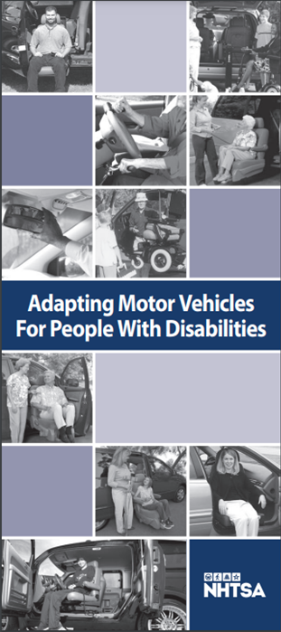
Driving Safer Longer - Adapting Your Vehicle
Vehicle adaptations
Larger panoramic rear and side mirrors
Pedal extenders to reach brake and gas
Hand controls for brake and gas
Steering device to aid in grabbing wheel
Seat belt adaptors
Torso restraints to hold driver upright
Turn signal adaptations
Left foot accelerator
Touch pad/voice activation systems for car controls/electronic joystick controls
NHTSA Brochure
The costs for these adaptations range widely.
Notes:
Vehicles can be adapted to address some changes in physical abilities, such as reduced flexibility. The costs for these adaptations range widely, but some are very low-cost.
Some of these adaptations are discussed at CarFit events.
Certified Driver Rehabilitation Specialists can assist in determining if these adaptations might be appropriate for a particular driver.

Slide 22
Questions?
  www.maturedriversnj.org

Slide 23
DRIVING RETIREMENT
How to Talk About Limiting or Stopping Driving
Transition to Living Car-free
Mobility Independence
Notes:
We can use the term driving retirement for the process of limiting and stopping driving - the analogy to retirement from work seems appropriate. It may be that the older driver can continue driving but may need to make some of the adjustments we mentioned earlier, such as driving during less busy times and only during the day, driving only to locations they are familiar with, and on local roads, or driving with someone.
If the decision has been made to limit driving or stop driving completely, the mature driver will be looking for a plan to maintain independence and self-sufficiency. The conversation about stopping driving can be difficult but preparing for the conversation can help.

Slide 24
Warning Signs of Unsafe Driving
Warning signs and symptoms
  Uncomfortable, fearful or nervous while driving
  Difficulty staying in travel lane
  Getting lost in familiar places
  Trouble paying attention to road signs, pavement markings
  Slowing down when faced with unexpected situation
  Experiencing near misses
  Trouble gauging gaps in traffic at intersections, exit ramps, merges, or changing lanes
  Being easily distracted
  Recent tickets or warnings
  Dents or scrapes on the car, garage, fences, mailbox
Notes:
How do we know when it is time for someone to reassess driving?
These warning signs and symptoms may give a family member or caregiver an indication that an older driver should consider limiting or stopping driving.
Do they seem uncomfortable, fearful or nervous while driving?
Do they have difficulty staying in their travel lane?
Have they become lost on familiar roads or in a familiar place?
Do they fail to pay attention to road signs, signals, or pavement markings?
Do they slow down when faced with an unexpected situation?
Have they experienced near misses?
Do they have trouble gauging gaps in traffic at intersections or exit ramps, or in merging situations, or changing lanes?
Are they easily distracted while driving?
Have they received tickets or warnings recently?
Have they misjudged a situation? Are there new dents or scrapes on the car, garage, fences, mailbox?

Slide 25
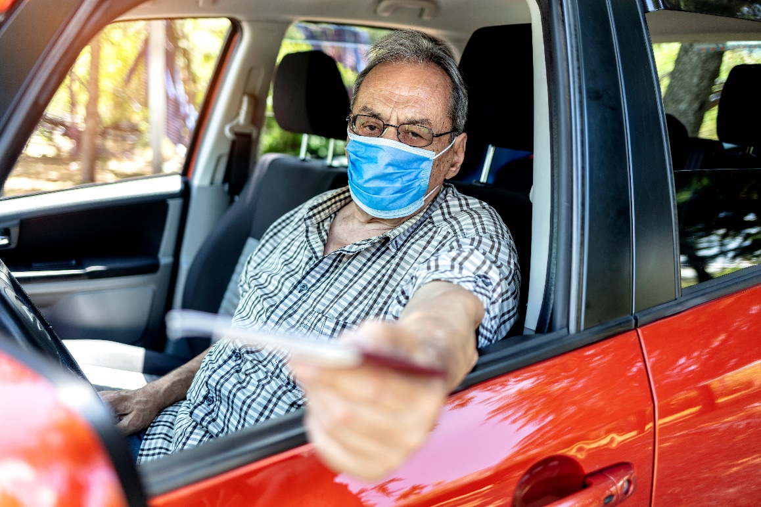
Driving Retirement
Think about:
Meaning of driving from the older driver’s perspective
How to begin the driving discussion
Strategies for driving reduction or retirement
How to talk about navigating the community as a non-driver
Local transportation options
Starting the conversation before a crash or other crisis occurs
Continuing the conversation over time
Notes:
If the decision has been made to start the discussion about driving retirement, take time to think about:
The meaning of driving from the older driver’s perspective
How to begin the driving discussion
Any community resources for driving evaluation and remediation
Strategies for driving reduction or retirement
How to talk about navigating the community as a non-driver
Local transportation options
It’s important to start this conversation before a crash or other crisis forces the conversation. This approach allows time to develop a plan for mobility after driving cessation.
Families are relieved by knowing that there is a plan. The older driver may be relieved that there are options and they are not forced to continue driving.
The conversation can be continued over time, giving the individual opportunity to become used to the idea and to explore transportation options

Slide 26
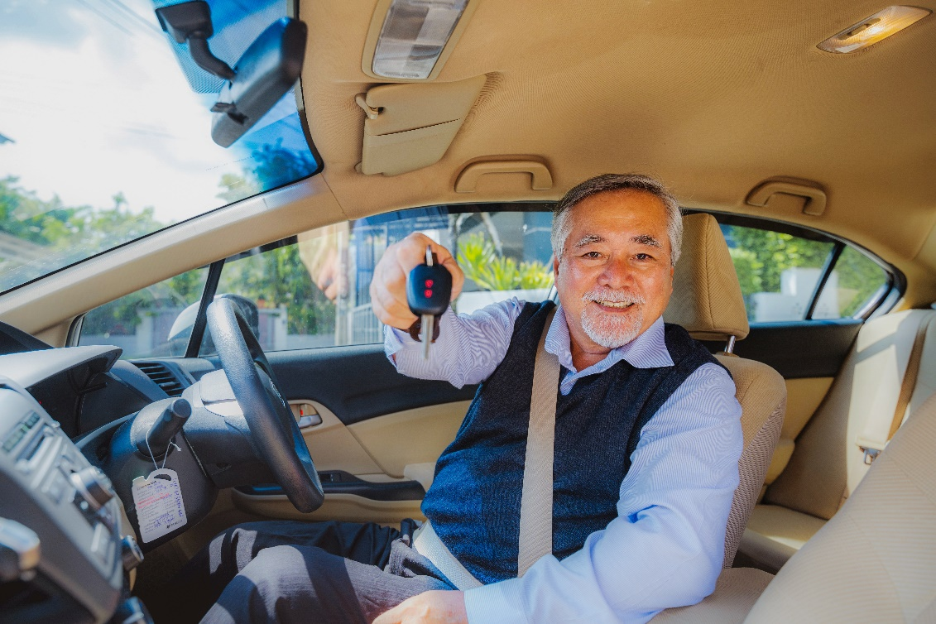
Driving Retirement
The older driver may fear being:
Unable to fulfill daily needs such as food, medication, exercise, social interactions
Dependent on others
Less spontaneous
Isolated and lonely
Less satisfied with life
Notes:
Why do we not want to stop driving even if we think we should?
We don’t know how we will get food, medication, or how we can keep doing everything we do now, like visiting friends or getting to the library or exercise class.
We don’t want to be dependent on others for getting around
We could not make spontaneous trips – every trip must be planned, unless we are walking or bicycling.
We will be isolated and feel lonely
We don’t know how to get around without a car
Any conversation with a mature driver has to take into account these and other fears. Isolation can negatively affect health so we want to make sure that individuals have alternatives to driving.

Slide 27
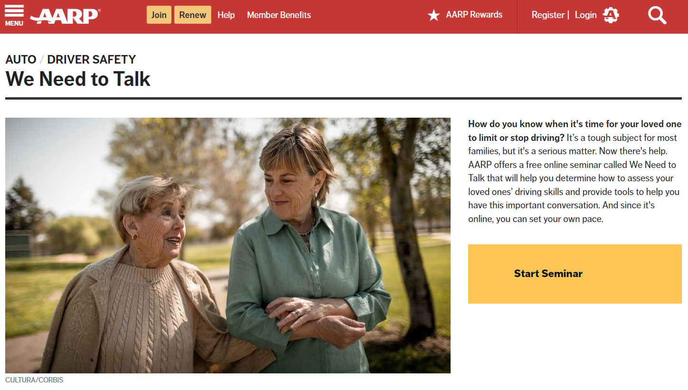
Driving Retirement
Family and friends may fear:
the older driver's response
appearing disrespectful
not being able to help with transportation
isolating the older driver
the older adult not asking others for rides
AARP We Need to Talk online seminar
Florida’s Guide to Safe Mobility for Life
Notes:
The conversation about when to stop driving can be difficult for everyone involved, but it is important to keep talking.
As a family member or caregiver, you might be concerned about:
The older driver's response
Appearing disrespectful
The fact that you or family members may not live nearby to help meet your loved ones’ transportation needs
Isolating the older driver if they live alone
The older adult not wanting to burden others for rides and so giving up on going places
Some resources to help think about this process:
AARP We Need to Talk online seminar
Florida’s Guide to Safe Mobility for Life

Slide 28

Driving Retirement
Conversation Starters
I am concerned about your safety when you are driving.
Driving isn’t what it used to be.
Have you asked your doctor about the effects of your new medication on driving?
I’m worried about you getting lost.
I’m glad you stopped driving at night. I don’t want you driving if you are uncomfortable or feel it’s too risky.
Early, occasional, and candid conversations
Notes:
The AARP We Need to Talk material suggests early, occasional, and candid conversations. Focus can be on the driver’s safety and level of comfort. Some example conversation starters include:
I am concerned about your safety when you are driving.
Driving isn’t what it used to be.
Have you asked your doctor about the effects of your new medication on driving?
I’m worried about you getting lost.
I’m glad you stopped driving at night. I don’t want you driving if you are uncomfortable or feel it’s too risky.

Slide 29

Mobility Independence
Reasons to stop driving
Safety of the driver and other road users
Costs of owning a car and the worry of repairs and maintenance
Health benefits of walking or bicycling
Lifestyle benefits such as meeting people, getting to know the neighborhood
Notes:
As we have been discussing, safety is the first reason to stop driving – safety of the mature driver, and safety of others using the road.
There are other arguments to be made:
Owning a car is expensive
If walking or bicycling is an option, remember the advantages include improved health, mood, opportunities to see neighbors, and reducing your carbon footprint

Slide 30

Mobility Independence
Type of Cost | Unit Cost | Frequency per Year | Total Cost per Year
Monthly Car Payment | $500 | x 12 | $6,000
Annual Routine Maintenance Cost (i.e. oil changes) | $110 | x 1 | $110
Annual Repair/Replacement Cost (i.e. tires, battery, transmission) | $300 | x 1 | $300
Annual Auto Insurance | $1,000 | x 1 | $1,000
Annual Licensing & Registration Fees | $40 | x 1 | $40
Monthly Gas/Parking/Toll Costs | $70 | x 12 | $840
Total Annual Cost |  |  | $8,290
Reasons to stop driving
Costs of owning a car and the worry of repairs and maintenance
Adapted from: http://safemobilityfl.com/pdfs/CarCostWorksheet.pdf
Notes:
We don’t often think of the total costs of owning and driving a car. This car cost calculator shows the real costs of driving a car including insurance, repairs and maintenance, and fuel that can add up to a significant portion of an older driver’s budget. The money saved can be put toward paying for the bus, taxi, or Uber or Lyft rides.
The chart shown here is just an example. AAA provides information on the annual cost of owning a new car at https://www.aaa.com/autorepair/articles/your-driving-costs, and offers a different online cost calculator here:
https://www.aaa.com/autorepair/drivingcosts
Note to Presenter:
You might want to fill in this sheet differently. You can point audience members to these resources;
Florida’s Guide to Safe Mobility for Life https://www.safemobilityfl.com/Guide.htm#transportationplan. A Spanish language version of the Car Cost Worksheet is available on this webpage.
2. AAA provides an annual cost of owning a new car at https://www.aaa.com/autorepair/articles/your-driving-costs,
and offers a different online cost calculator here: https://www.aaa.com/autorepair/drivingcosts

Slide 31

Mobility Independence
Needs of driving retirees:
How do I get food?
How do I get to medical appointments?
How do I get to the park to walk? To the gym?
How do I do other errands?
How do I get to worship services?
How do I visit friends?
Notes:
It’s not just a matter of how driving retirees will feel – they need practical answers to questions such as:
How do I get food?
How do I get to medical appointments?
How do I get to the park to walk? To the gym?
How do I do other errands?
How do I get to worship services?
How do I visit friends?
And of course these are just a few of the activities they will want to continue.

Slide 32


Mobility Independence
Mobility Options:
Rides with Friends & Family
Walkability – “Complete Streets”
Accessible Fixed Route Transportation
Access Link– Paratransit
Community Transportation
Mobility on Demand (UBER, Lyft)
?
Notes:
What are the options for alternative transportation?
Asking family and friends for rides.
How walkable is their community? If the individual has the ability to walk the distance to what is needed, this is an option.
NJ TRANSIT buses are in many communities and frequently have routes to nearby shopping centers/malls.
Specialized transportation is available in all counties – paratransit, available by appointments ahead of time, can make routine essential travel, such as to the doctors office, easier
Other community transportation – such as vans
Taxis, Uber and Lyft provide transportation in NJ communities.

Slide 33
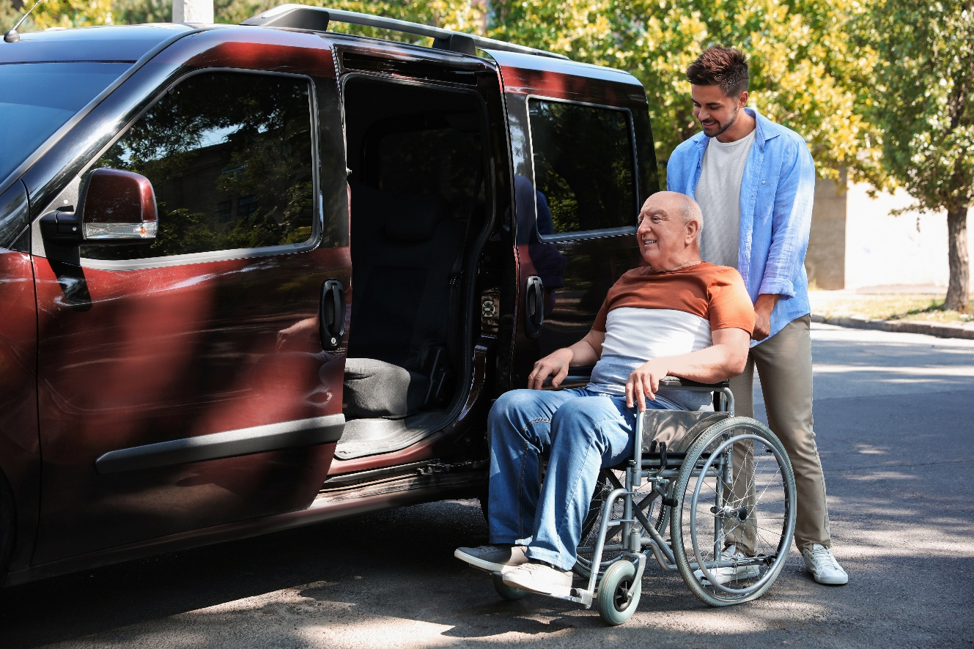
Mobility Independence
What are the options in this community?
Local Senior Bus?
Walking/bicycling?
Ride with volunteer driver?
Ride hailing/ Ride sharing?
Paratransit?
NJ TRANSIT?
Notes:
What are the options in our community?
We have…..
If the mature driver lives in another community, you could contact the Office on Aging in that town and ask about transportation options.
Note to Presenters:
If you have information on these options in your community, you can change this slide or add a slide to this presentation, or print out information for your audience. For example, how to schedule the community van to pick someone up and the acceptable destinations.

Slide 34
Transition to Living Car-free
Create a plan
  Where do I want to go?
  How often do I go?
  How far?
  What options are available?
    First choice
    Alternative
  Can I combine a trip or mode?
Destinations
Classes | Movies/Museums/Theaters
Community Center | Park
Community Events | Pharmacy
Doctor Dentist | Place of Worship
Family | Restaurants
Friends | Other shopping
Grocery/Supermarket | Sporting Events
Hair Salon/Barbershop | Veterinarian
Health Club | Volunteering
Library | Work
Florida’s Guide to Safe Mobility for Life
Notes:
The key to a successful transition from driving is planning. You want to talk about not only needed excursions but desired trips. Then build on that list to find ways to meet these needs. These are some of the destinations that people will want to access.
The idea is to reassure the individual that when they give up the keys they will not be house-bound, that there are alternatives to driving and their needs can be met.
Florida Safe Mobility for Life
AAA
https://exchange.aaa.com/wp-content/uploads/2021/03/Senior-Transportation-Mobility-Planner.pdf
CDC Mobility Plan
https://www.cdc.gov/transportationsafety/older_adult_drivers/mymobility/index.html?CDC_AA_refVal=https%3A%2F%2Fwww.cdc.gov%2Fmotorvehiclesafety%2Folder_adult_drivers%2Fmymobility%2Findex.html

Slide 35
Transition to Living Car-free
Sample Transportation Plan
Create a transportation plan
  List all destinations
  List all transportation options
  Ensure option is comfortable
  Ensure option is practical
  Ensure option is affordable
  Organize by week or month
Where do I want to go? | How often? | How far? | What options are available? | Preferred Choice | Alternative | Option to Combine Trips?
Visit Family |  |  | Ride with Family, Uber/Lyft, Bus
Grocery Store |  |  | Senior Bus, Access Link, Grocery Delivery
Exercise Class / Park |  |  | Walk
Book Club |  |  | Walk, Ride with Friend
Medical Appt.
Community Center | Once/week Tuesday a.m. | 1 mile | Ride w/ friend Senior van Lyft ride | Ride w/ friend | Senior van (Van to return home) | N/A
Place of Worship
Notes:
The transportation plan will answer the questions:
Where do I want to go?
How often do I go?
How far away is it?
What transportation options are available?
First choice
Alternative
Can I combine trips, or use two modes to get there?
For example:
I want to go to the senior center once a week on Tuesday mornings. It’s a mile away. I could get a ride from my friend who is still driving, or I could take the municipal van, or I could get a Lyft ride. I know the municipal van will be there to bring me home.
You want to make sure that all destinations are listed and all transportation options are listed.
Only include options that are comfortable for the individual, or that they will really use.
Ensure that the option is practical. If the bus schedule does not work for the individual, it is not really an option.
Once the plan is complete, test it out to see if it works for the individual.
Note to Presenter:
As part of your work with the community, you can encourage people to create a written transportation plan, and take time to go through it as part of your presentation, or give them a print-out of the plan from the Mature Driver website that they can complete on their own.
Participants may want to look at the following resources:
Florida Guide to Safe Mobility for Life
https://www.safemobilityfl.com/Guide.htm#transportationplan. A Spanish language version of a transportation plan is available on this webpage.
AAA
https://exchange.aaa.com/wp-content/uploads/2021/03/Senior-Transportation-Mobility-Planner.pdf

Slide 36

Resources
NHTSA How to Understand and Influence Older Drivers
AARP/Hartford We Need to Talk
AAA Senior Driver
National Institute on Aging
Notes:
Several resources are available to provide guidance through the process of driving retirement.
National Highway Traffic Safety Administration
AARP and Hartford Insurance
https://exchange.aaa.com/wp-content/uploads/2021/03/Senior-Transportation-Mobility-Planner.pdf
AAA Foundation for Traffic Safety
National Institute on Aging

Slide 37
Questions?
  www.maturedriversnj.org

Slide 38
Transportation SErvices
NJ TRANSIT
Paratransit
Mobility on Demand
Concierge Services
Family and Friends
Complete Streets
Delivery
Notes:
Familiarity with the transportation services available to your community will help you in advising community members about their options.

Slide 39

Transportation Services
NJ TRANSIT
  Fixed route, schedule
    Bus
    Train
    Light Rail
  Half-price fares for passengers 62+ years of age (65 for Metro-North Railroad)
    Discount available with proof of age
  Accessibility
Notes:
NJ TRANSIT offers bus, train and light rail service throughout the state, and connects with other transportation providers at major locations across the system, including AMTRAK, the PATH to New York City, and SEPTA to Philadelphia.
For those 62 years of age and older, half price fares are available with proof of age. The MetroNorth line is the only line that requires passengers to be 65 to be eligible for half-price fares. Proof of age is any ID or document issued by a government, social service, or mass transportation agency, and printed with the rider’s date of birth.
What is accessible?
All buses are accessible with bus lifts or ramps, and all buses have securement systems for mobility devices. The lift can be used by anyone. You do not have to be using a mobility device.
Many rail stations are accessible with elevators, ramps, mini high-level platforms, or portable lifts
Bridge plates are available at all high and mini-high level platforms for boarding trains.
Details on accessibility are available on the NJ TRANSIT website

Slide 40

Transportation Services
Paratransit
NJ TRANSIT Access Link
    curb to curb service
    eligibility process
    need reservations
    ADA complementary
Contact:
    (800) 955-ADA1(2321)
    (800) 955-6765 (TT)
    adaservices@njtransit.com
Notes:
NJ TRANSIT provides paratransit service. Under the Americans with Disabilities Act or ADA, transit agencies must provide paratransit services for people with disabilities who cannot use fixed route transit services. In NJ, this NJ TRANSIT service is called Access Link. Access Link is for people with disabilities who are unable to use the local fixed route bus for some or all of their rides. There is an eligibility process.
Access Link will provide transportation service when the origin and destination are within ¾ mile of a NJ TRANSIT local fixed bus route. It does not serve as regional transportation, into New York City for instance. It operates as curb to curb service and requires reservations.
Contact Information:
(800) 955-ADA1(2321)
(800) 955-6765 (TT)
adaservices@njtransit.com

Slide 41
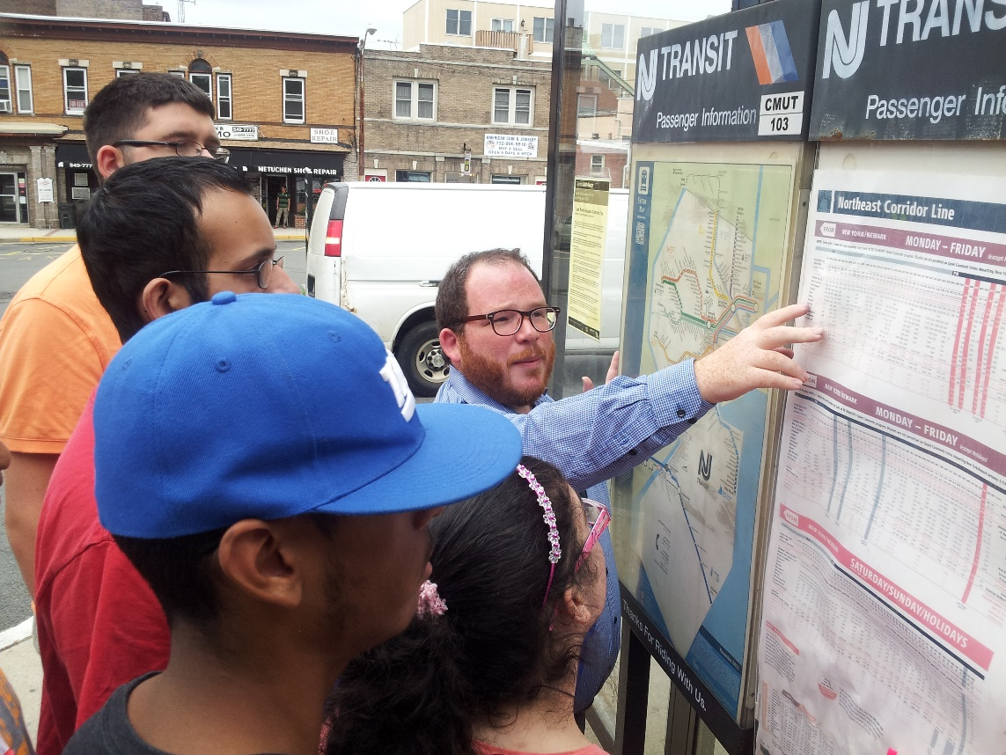
NJTIP @ Rutgers
  Unsure how to use public transit?
  NJ Travel Independence Program at Rutgers teaches how to:
  Read bus and train schedules
  Plan trips
  Pay fares
  Take safety precautions
  Contact:
  Phone: 848-932-4499
  Email: njtip_info@njtip.rutgers.edu
Notes:
Older individuals who own cars are used to getting around by driving and may not have used public transit for years, or ever.
The NJ Travel Independence Program (TIP) at Rutgers teaches individuals with disabilities and older adults how to use public transportation safely and independently. NJTIP customers learn how to read bus and train schedules, plan their trips, pay their fares and take safety precautions. The only cost to customers during training is paying their own fares. For more information call (848) 932-4499 or email: njtip_info@njtip.rutgers.edu . Additional information on NJTIP can be found at njtip.rutgers.edu website.
Benefits include:
Increased Access
Empowerment and Independence
More Options
“Chauffeur Retirement”
Cost Savings

Slide 42
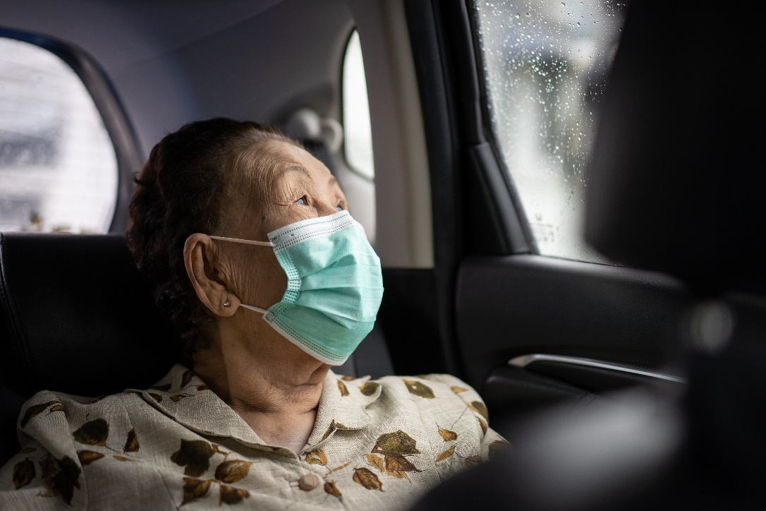
Community Transportation Services
Community Transportation Services
Use smaller lift-equipped vans and minibuses
May operate curb to curb, door to door, or on an advance reservation basis
May feed into existing mass transit bus stops, train or light rail stations
May have eligibility requirements and may be restricted to senior citizens, people with disabilities, or social services clients
Available in all NJ Counties
County transportation links
Notes:
Community Transportation providers use smaller lift equipped vans and minibuses and may operate curb to curb, door to door, or on an advance reservation basis.
Every county provides these services. Services may feed into existing mass transit bus stops, train or light rail stations.
Although there are some services open to the general public, others have eligibility requirements and may be restricted to senior citizens, people with disabilities, or social services clients.
Go to the Mature Driver website for links to your county webpage. https://maturedriversnj.org/?page_id=219&fb-edit=1
In addition, many municipalities provide older residents with transport via a van or small bus. Information about these services often can be found through a municipality’s Office on Aging.
Local non-profit organizations also may operate transportation services.

Slide 43

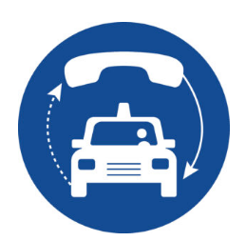

Transportation Services
Mobility on Demand
Taxi
Ride hailing/Ride sharing
  Lyft & Uber
  App needed
Concierge Services
  Go Go Grandparent
  EZ Ryde4Life
Notes:
Taxis and ride hailing companies are known as Mobility on demand services. Transportation Network Companies (TNCs) such as Lyft and Uber pair passengers with drivers via websites and mobile apps. Drivers provide transportation in the driver's non-commercial vehicle.
If the individual is not comfortable with phone apps, concierge services such as Go Go Grandparent and EZ Ryde4Life help older adults link to Lyft and Uber. People do not have to have facility with technology. Go Go Grandparent and Ryde4Life are available in NJ. There is an annual membership fee and an administrative fee, and rides are pre-paid.

Slide 44
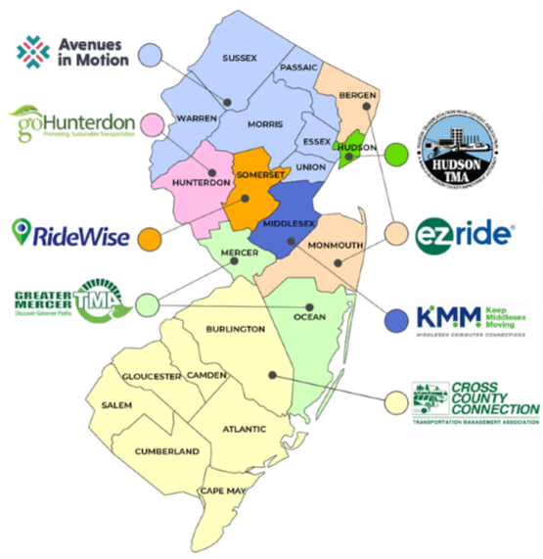
Transportation Management Associations
TMA | Webpage
Cross County Connection | Seniors and Accessible Services
Greater Mercer TMA | Ride Provide Other Resources
EZ Ride | Ryde4Life
goHunterdon | Community Mobility
Hudson TMA | Transportation for Seniors
Keep Middlesex Moving | Active Adult Transportation
RideWise | Somerset County Transportation Guide Municipal Transportation
Avenues in Motion | Programs for Older Adults
Notes:
NJ’s 8 Regional Transportation Management Associations or TMAs are non-profit public/private partnerships that provide transportation information and services to facilitate the movement of people and good within their service regions.
Many provide targeted services to older adults as drivers, passengers, commuters, transit riders, bicyclists and pedestrians. TMAs can help residents navigate through a range of mobility options including services provided by municipalities, counties, local non-profit providers, private bus carriers, and NJ TRANSIT. Some provide classes about transportation, and some have information by municipality.
When visiting their websites, look for sections on Community Mobility, Mobility Guide, Senior Programs, Seniors and Accessible Services, and Transportation for Seniors. The maturedriversnj.org website provides links directly to TMA transportation services.

Slide 45

Walkability and Bikeability
A walkable community
  Improves quality of life – people interact and develop a sense of community
People living in a walkable community
  More likely to be socially engaged and trusting
  In better health and happier more often
NHTSA – Stepping Out as an Older Adult
Pedestrian Safety Workshop: A Focus on Older Adults
Complete Streets
Health in Aging Foundation Walking Tips
Notes:
A walkable community improves overall quality of life by creating an environment where people are encouraged to interact and develop a sense of community [4].
In fact, research indicates that “…people who live in walkable communities are more likely to be socially engaged and trusting than residents of less walkable neighborhoods…[and also report] being in better health and happier more often” [5].
By keeping fit and maintaining flexibility, older individuals may be extending their ability to drive, and are keeping healthy.
Complete Streets are designed and operated with the safety, mobility and accessibility needs of users of all ages and abilities in mind.
Investigate these websites for information on pedestrian safety for mature adults. As we have discussed, arthritis, vision and hearing limitations, and agility, among other issues, can affect safety.
Note to Presenters:
You may want to change the script here to fit your community. If there is a lack of sidewalks, or safe places to ride a bike, or if your town has a trail system that you want to highlight, you can add a slide or talk more extensively here about possibilities. The Pedestrian Safety Workshop: A Focus on Older Adults is a guide to encouraging a conversation among community members on improving the pedestrian environment to increase safety of older adults and others. You may want to create a discussion in your community about improving pedestrian and bicycle infrastructure to encourage walking and bicycling.
https://www.aarp.org/livable-communities/act/walkable-livable-communities/info-2013/pedestrian-safety-workshop-focus-on-older-adults.html

Slide 46

Delivery Services
Shopping
Groceries
Household Goods
Clothing
Books
Pet food
Meals
Meals on Wheels
Restaurants
Pharmacy
Medication
Notes:
In the past few years, we have seen an increase in delivery options from a wide range of retail stores. We can have groceries, clothing, pet food, hardware, meals, medications, and books delivered. This option may reduce the need for some trips out. Accessing these services does take some ability with online systems or phone apps. Ask businesses in your area if they offer delivery.
Meals on Wheels are delivered by volunteers who also provide some social connection. Information can be found through every county’s Department on Aging or by going to the link here and entering a zip code.
With these delivery options, the need for rides can focus on getting to the doctor, visiting friends and family, going to exercise class.
Note to Presenter:
You may want to provide a list of businesses that will deliver to your community members, or ask the municipal chamber of commerce or Main Street program to provide this information.

Slide 47

Reducing Isolation: Online access to cultural, social, recreational activities
Participating in cultural, social and recreational activities online
requires training in use of technology
Examples
Online book groups
Museum talks and tours
Readings
Meetings
Courses
Theater programs
Public Library Free Services
Notes:
Online offerings of cultural, social, recreational activities have increased including
Online book groups
Museum talks and tours
Readings
Meetings
Courses
Theater programs
Access to these offerings requires some training in the use of technology. They may be an option, for example, when the weather is bad.
In addition, explore the offerings at local public libraries: Overdrive, Libby, Kanopy, among others – provides access to ebooks, audiobooks, videos

Slide 48
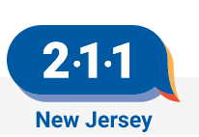



Resources
Other Transportation Information:
  2-1-1 New Jersey
  National Aging and Disability Transportation Center
  Rides in Sight
  DailyCaring
Notes:
The 2-1-1 New Jersey Transportation page has several categories to choose from. They provide live assistance 24 hours a day, every day of the year, including information on transportation options. Their services are free, confidential and multilingual.
https://www.nj211.org/resource-search/topic/transportation
Other resources for alternative transportation include:
National Aging and Disability Transportation Center
https://www.nadtc.org/
Rides in Sight
https://ridesinsight.org/rides-in-sight/
DailyCaring
https://dailycaring.com/8-ridesharing-services-for-seniors/
https://dailycaring.com/6-tips-for-hiring-a-caregiver-to-drive-your-senior/

Slide 49
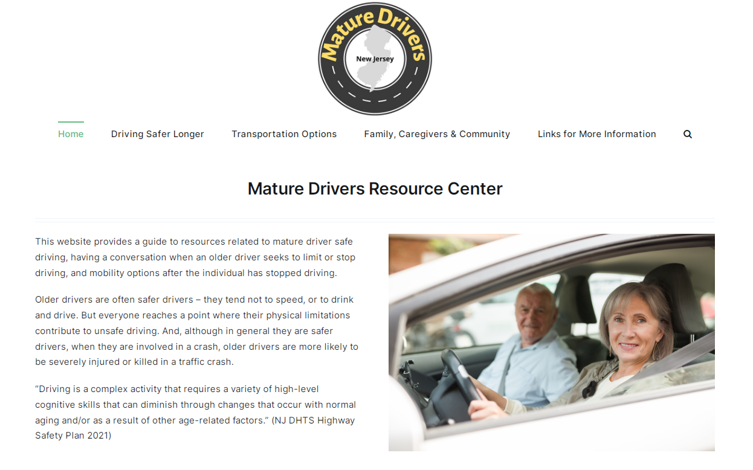
Resources
NJ Mature Driver Resource Center
  www.maturedriversnj.org
Notes:
The Mature Drivers website provides information and links to resources to address all the topics we covered today – driving safer longer through assessment, training and …., physical changes that affect driving, transportation options, and resources for family and caregivers to help in limiting driving and the transition to car-free living.
Go to maturedriversnj.org.

Slide 50
Questions?
  www.maturedriversnj.org
Notes:
As suggested in the presentation, you can add slides to provide information specific to your audience.
Sean is passing out the survey. We appreciate your feedback. We want to make this presentation as useful and relevant as possible. If you have any questions in the future, you can contact NJ Safe Routes Resource Center at

Slide 51
Acknowledgement
This presentation was supported by the New Jersey Division of Highway Traffic Safety with funding from the United States Department of Transportation's Federal Highway Administration. New Jersey and the United States Government assume no liability for its contents or its use thereof.
The Alan M. Voorhees Transportation Center (VTC) is a national leader in the research and development of innovative transportation policy. Located within the Edward J. Bloustein School of Planning and Public Policy at Rutgers University, VTC has the full array of resources from a major research university on transportation issues of regional and national significance.

